Slide 1

BASIC ELECTRICAL AND ELECTRONICS ENGINEERING
Course Code: CSE1002
SCHOOL OF COMPUTER SCIENCE ENGINEERING AND APPLICATIONS
Mrunmayee Rahate
Assistant Professor, DYPIU

Slide 2
Module 3: Bipolar Junction Transistors and MOSFET
Lecture 3: Numerical on BJT, BJT as a Switch and Amplifier

Slide 3
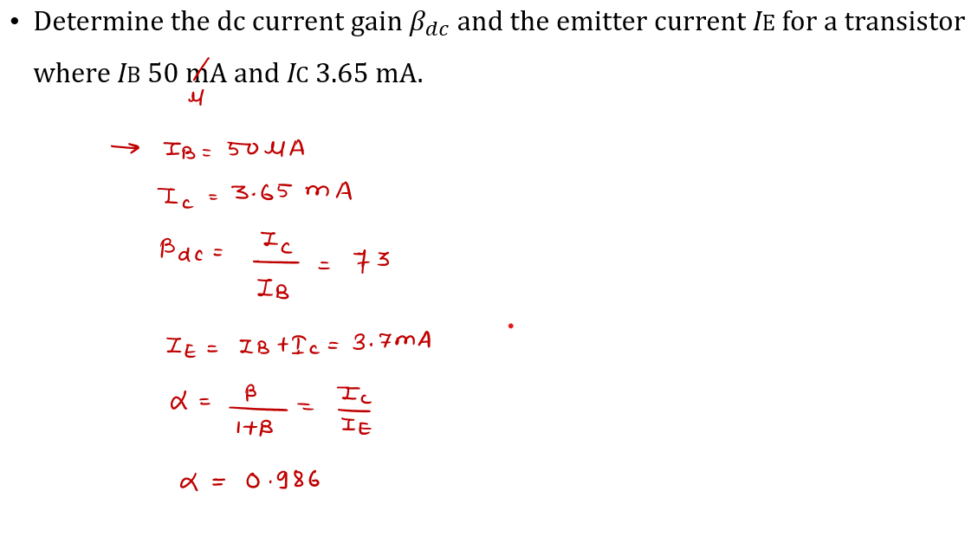
Bipolar Junction Transistor: Numerical

Slide 4
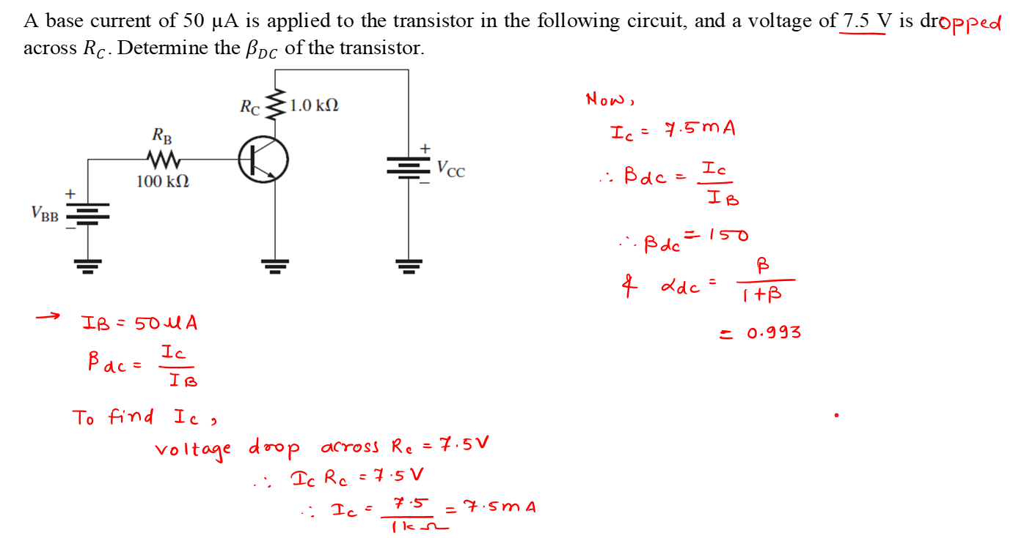
Bipolar Junction Transistor: Numerical

Slide 5
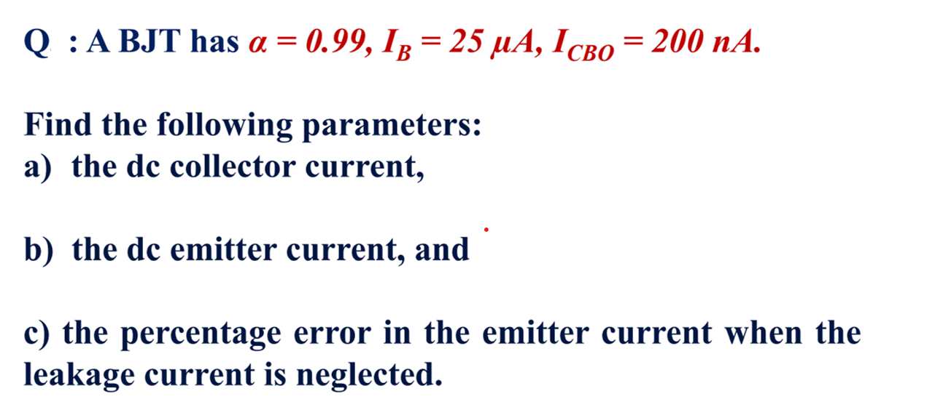
Bipolar Junction Transistor: Numerical

Slide 6
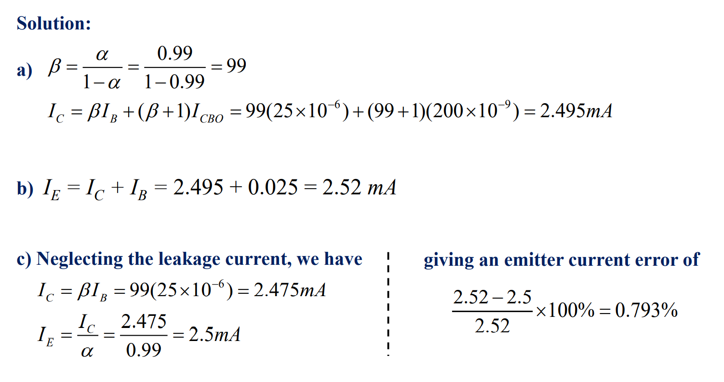
Bipolar Junction Transistor: Numerical

Slide 7
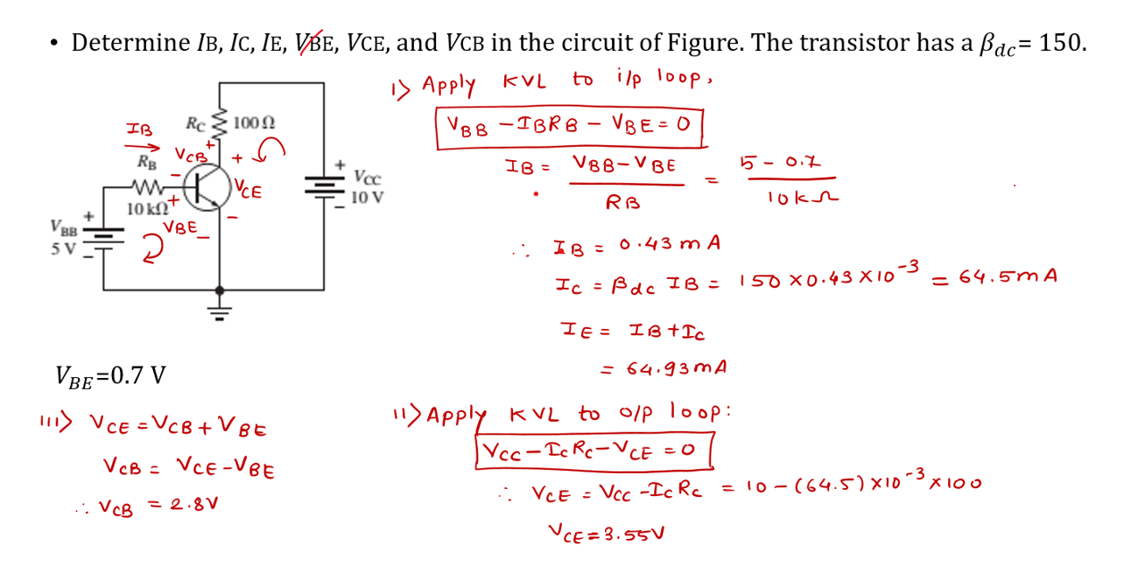
Bipolar Junction Transistor: Numerical

Slide 8
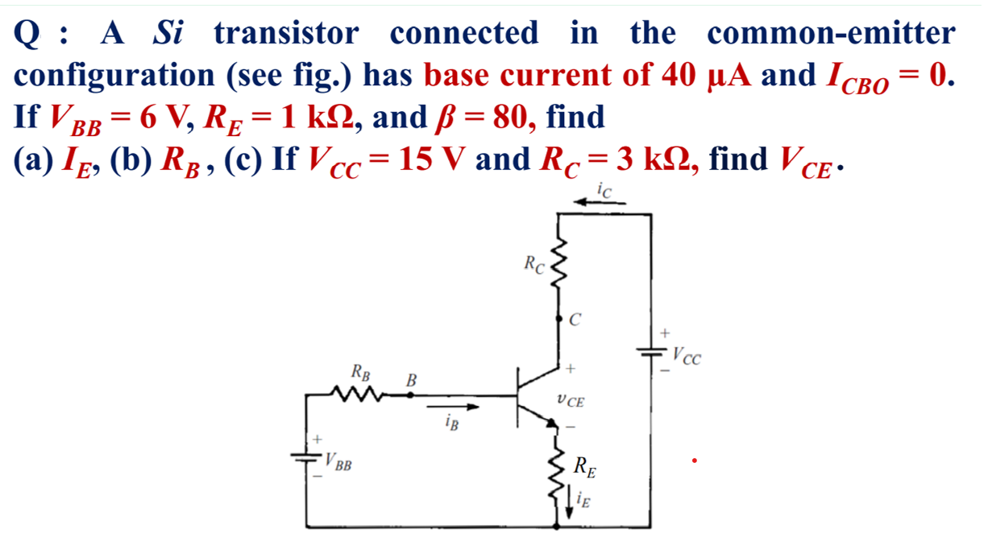
Bipolar Junction Transistor: Numerical

Slide 9
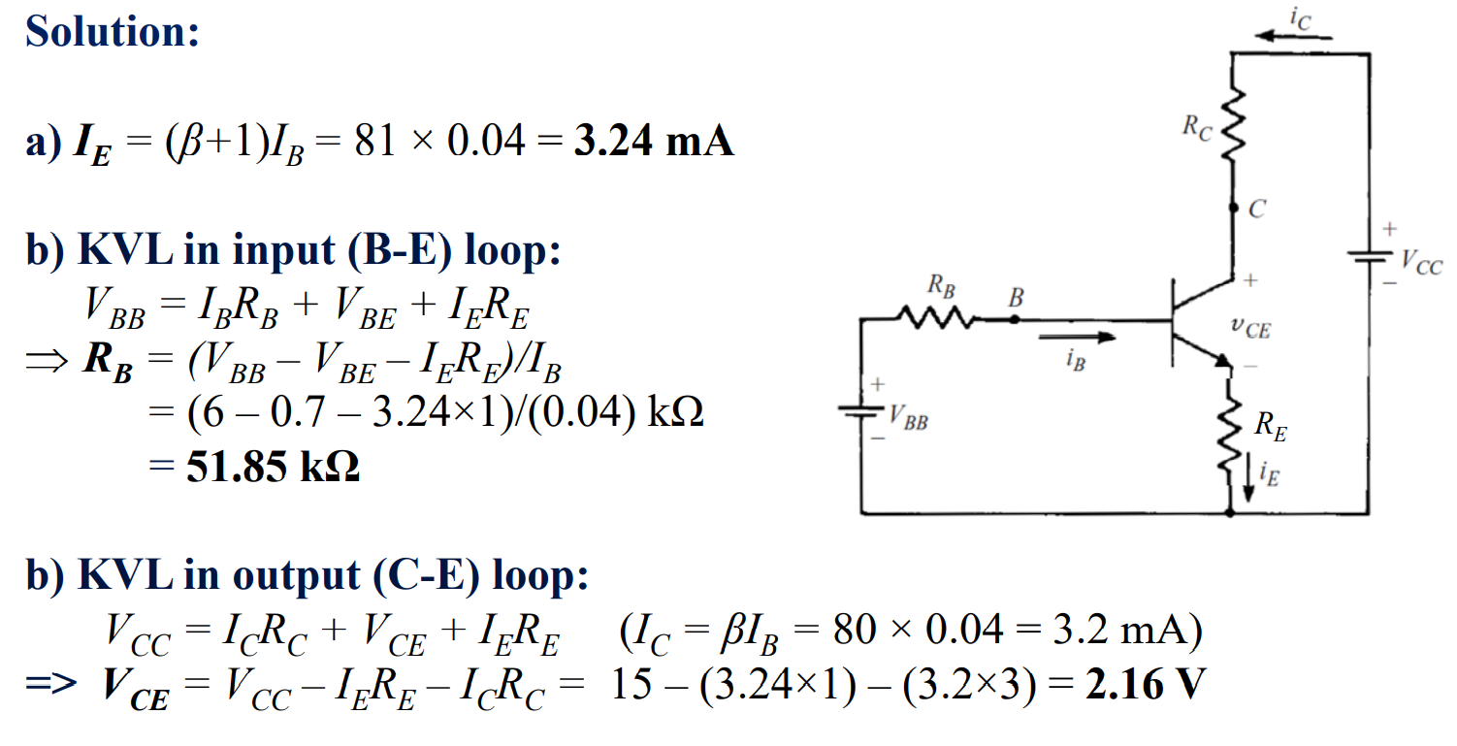
Bipolar Junction Transistor: Numerical

Slide 10
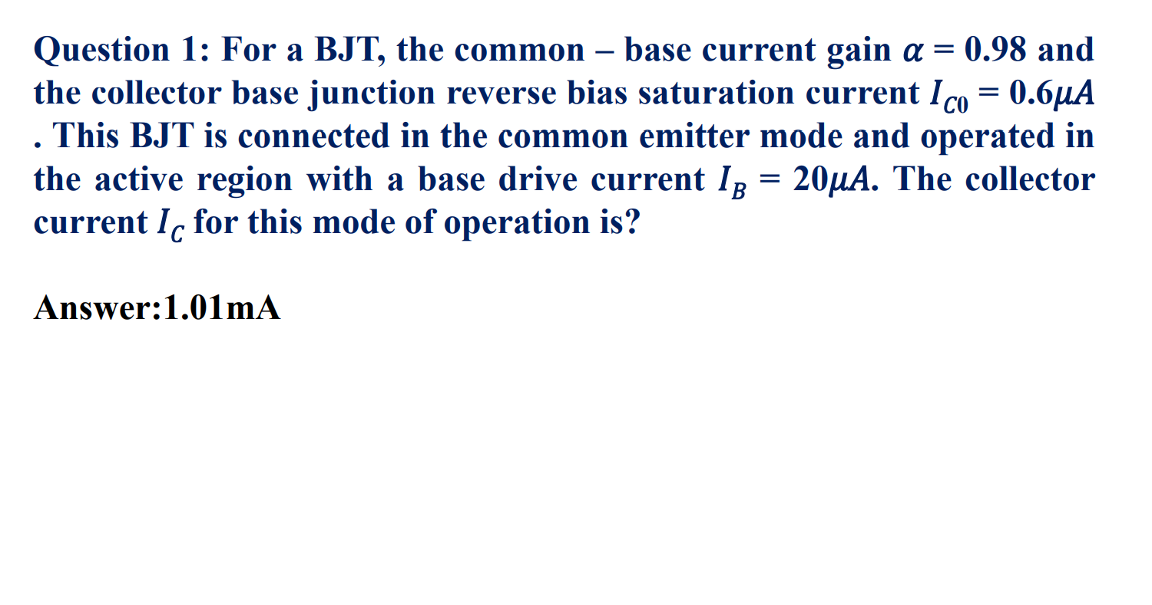
Bipolar Junction Transistor: Numerical for practice

Slide 11
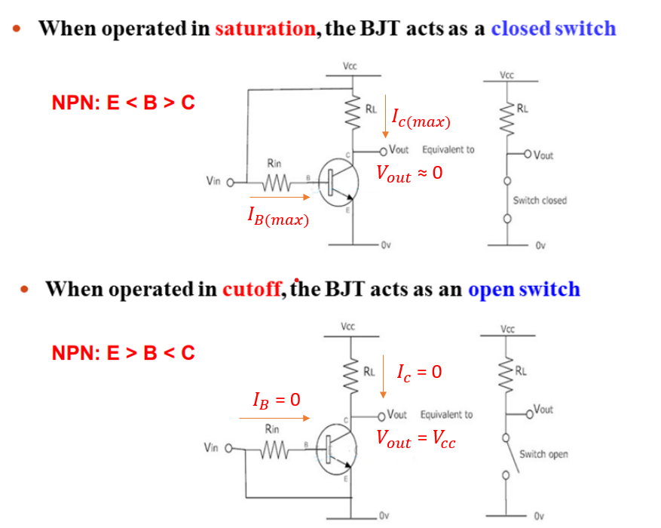
Bipolar Junction Transistor (bjt) As a switch

Slide 12
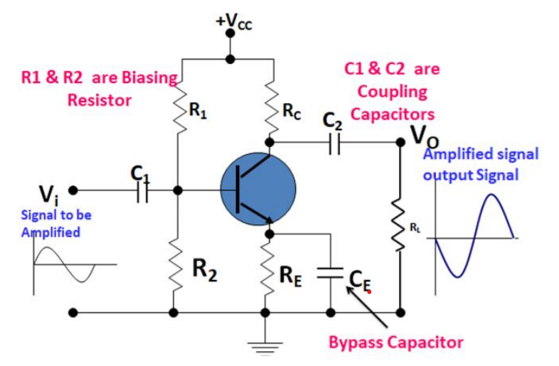
Bipolar Junction Transistor (bjt) As an amplifier

Slide 13
Thank You !!!

